Slide 1

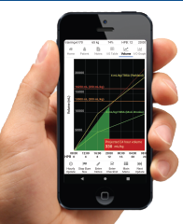
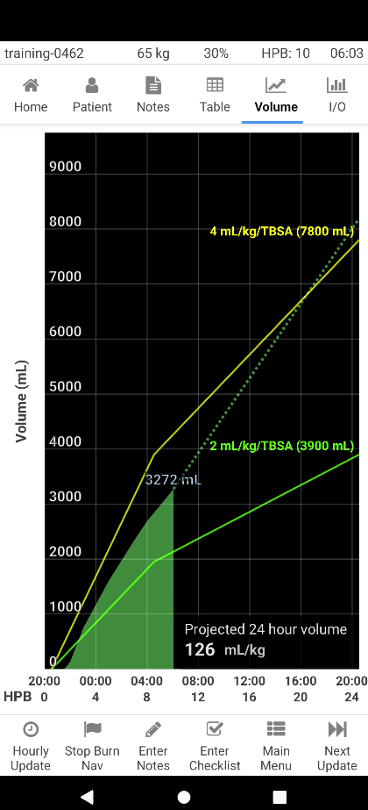
Burn Navigator ®
Phone App Education
Mar 2023
© 2023 Arcos, Inc.

Slide 2
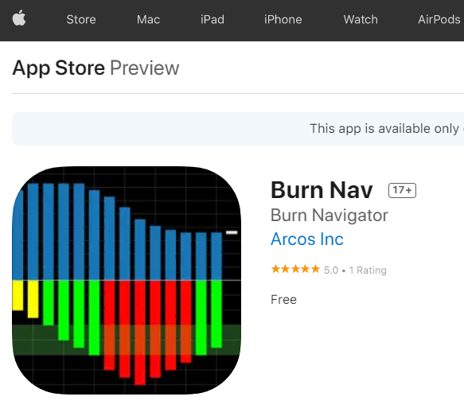
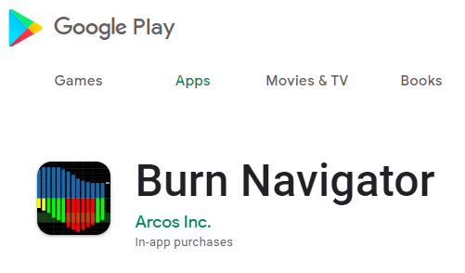
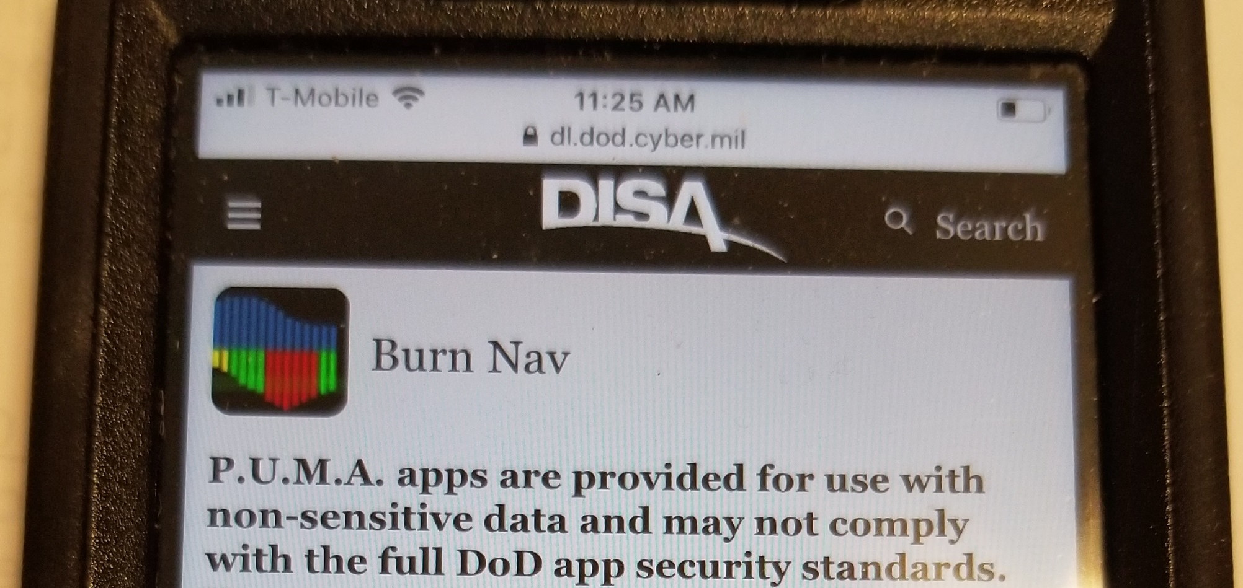
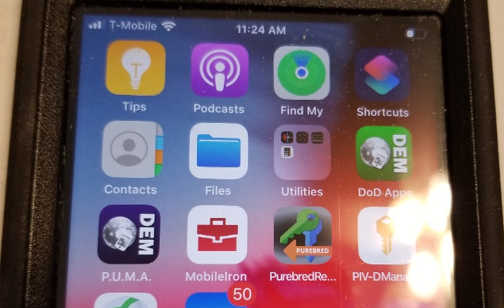
Download on Android Phones or iPhones
Also available on DISA P.U.M.A. app store
Free for training, license/in-app purchase for clinical use

Slide 3
Part 1: Clinical Background

Slide 4
Clinical Goal of Burn Fluid Resuscitation
Maintain adequate tissue perfusion at the least physiological cost of fluid¹
  Over-resuscitation complications
    edema, increased risk of compartment syndromes, ARDS, mortality
  Under-resuscitation complications
    acute kidney injury, burn shock, organ failure, mortality
1 Rizzo, J., et al. "The Battle of the Titans–Comparing Resuscitation Between Five Major Burn Centers Using the Burn Navigator." Journal of Burn Care & Research (2022) https://doi.org/10.1093/jbcr/irac095

Slide 5
Clinical Goal of Burn Fluid Resuscitation
Urine output is a good, but sometimes flawed, surrogate of tissue perfusion
  If UO is high, reduce IV fluid rate
  If UO is low, increase IV fluid rate
UO may be flawed or skewed due to ESRD, renal insult, ethanol/alcohol abuse, meth/narcotic use, baseline diuretic, …
Consider Hb/Hct, lactate, base excess, HR, BP, SVV in addition to UO

Slide 6
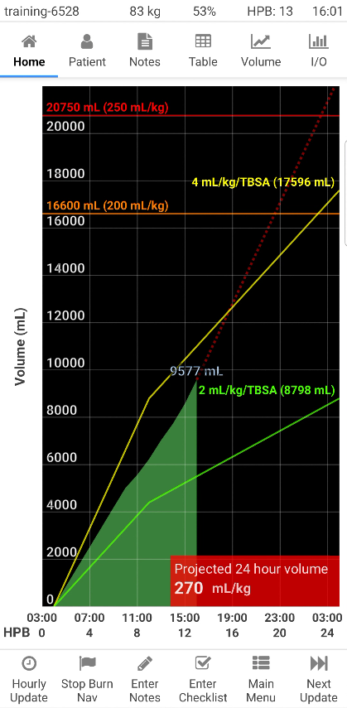
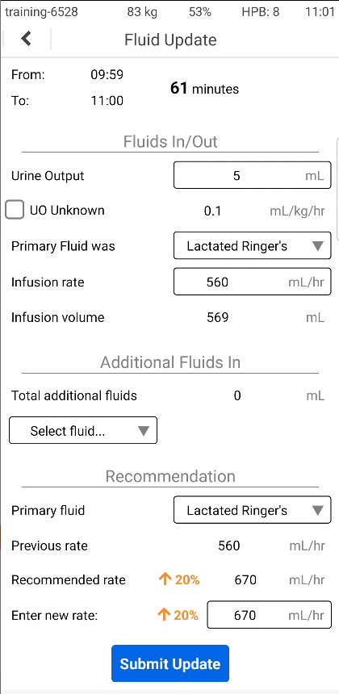
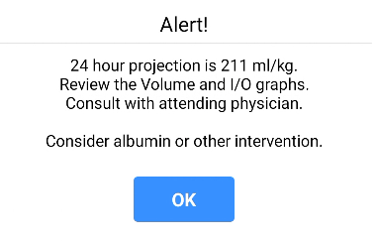
Burn Navigator
implements your UO-based protocol for burn fluid resuscitations
provides graphs to visualize resuscitations
facilitates team communication
provides fluid projections, patient safety alerts and prompts to escalate to senior providers
provides reports for M&M, QI and CSV files for research

Slide 7
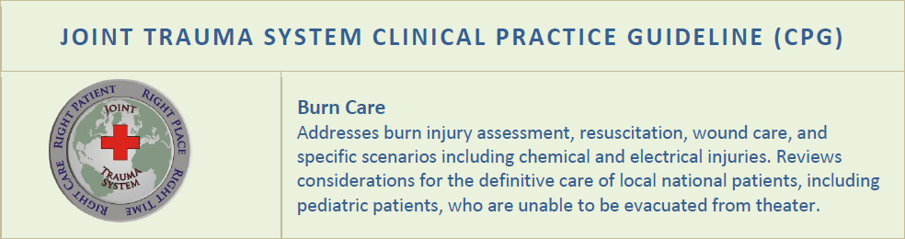
Burn Navigator
Was invented at the U.S. Army Institute of Surgical Research (USAISR)
First prototype was used clinically at USAISR in 2007
Has been used with over a thousand severe burn patients at USAISR, Parkland, Arizona Burn Center, Harborview Medical Center (Seattle), UTMB-Galveston, Vanderbilt, University of Alabama Birmingham and international locations
Is recommended by the U.S. Department of Defense Joint Trauma System CPG for Burn Care since 2016

Slide 8
Multi-Center Observational Data¹
5 U.S. Burn Centers, 285 patients
“Followed Burn Navigator” (FBN) if 83%+ of recommendations accepted
FBN: average 4.07 mL/kg/TBSA and 151.48 mL/kg of primary fluids given in first 24 hours
FBN: significant decrease in incidence of burn shock
Early initiation of BN resulted in lower overall fluid volumes
1 Rizzo JA, Liu NT, Coates EC et al. Initial results of the American Burn Association Observational Multicenter Evaluation on the Effectiveness of the Burn Navigator. J Burn Care Res. 43(3) May/June 2022, p 728-734. https://doi.org/10.1093/jbcr/irab182

Slide 9
Indications For Use
Burn Navigator is indicated for use in the care of
  adult patients with 20% or more Total Body Surface Area (TBSA) burned, or
  pediatric patients, 24 months old or older, weighing at least 10 kg with 15% or more TBSA burned,
  as a fluid resuscitation monitor and calculator for hourly fluid recommendations.
Burn Navigator is intended to be used for burn patients of all ages, weights and co-morbidities as a fluid resuscitation monitor.
Burn Navigator is intended to be initiated within 24 hours of the burn incident and to be used no longer than 72 hours post burn.

Slide 10
Volume Graph
Ivy Index
Higher risk of ACS & mortality
Projection Line
Where fluids will be at 24 hours with current rate
(see also bottom right box)
Green Mountain
Cumulative resuscitation fluids
Current cumulative volume is labeled at the “peak”
(9577 mL in this example)
Guidelines
Parkland 4mL/kg/TBSA (Yellow)
Modified Brooke (Green)

Slide 11
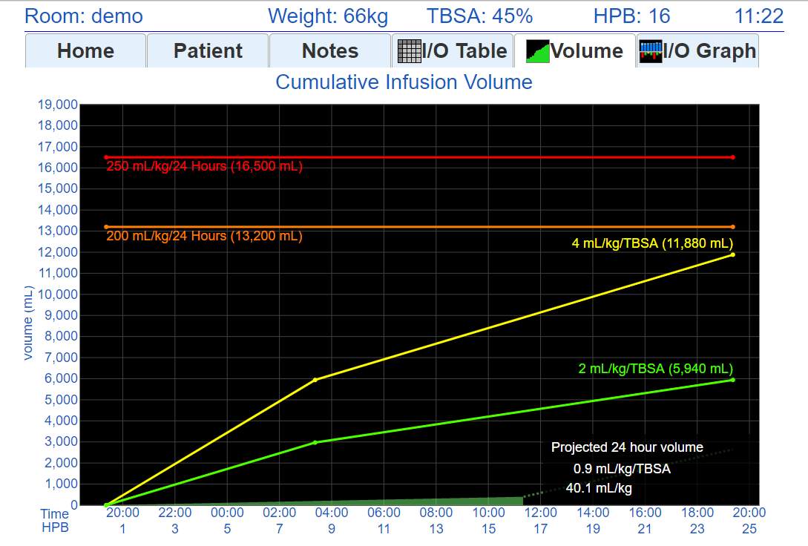
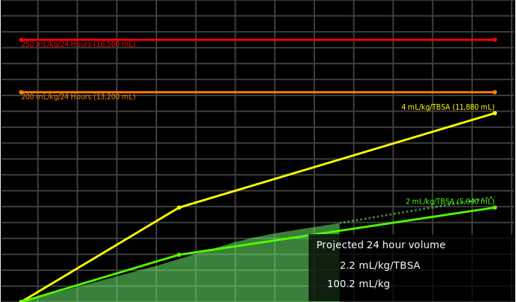

Resuscitation
Example
If UO/tissue perfusion is adequate, this volume of fluids is sufficient
100 mL/kg

Slide 12
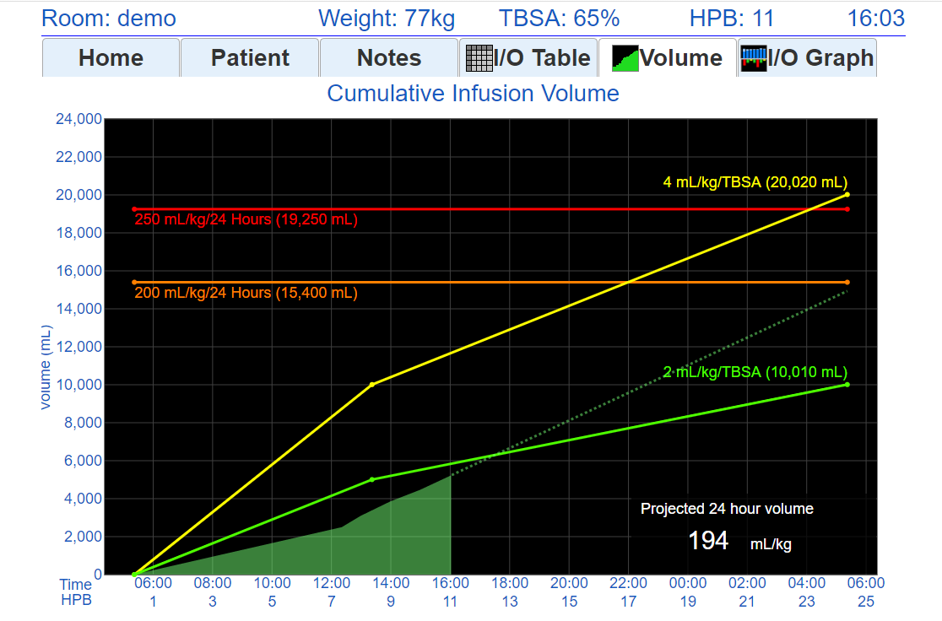
Resuscitation
Example
Likely under-resuscitated pre-hospital
Resuscitation more on track now

Slide 13
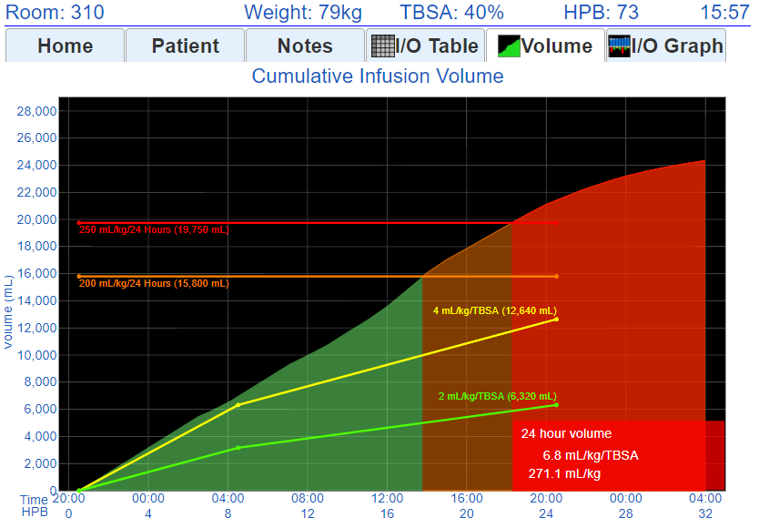

Resuscitation
Example
(Likely) Over-resuscitated
UO did not respond to increasing IV fluid rates, IV fluid was not turned down soon enough
Projected 24 hour volume

Slide 14
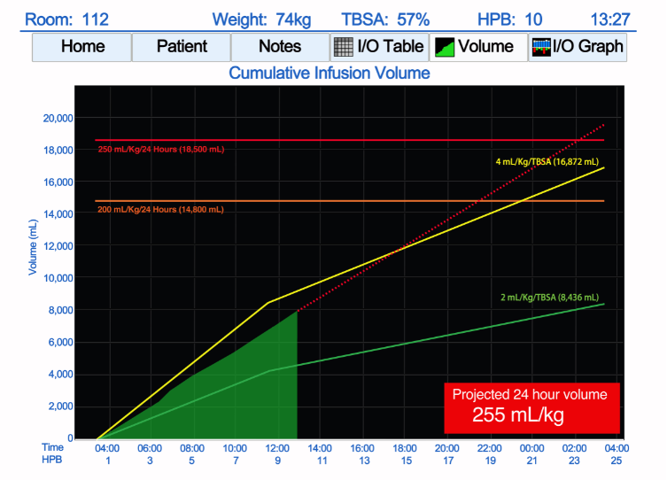
Resuscitation
Example
Resuscitation going well so far, but projection exceeds Ivy Index
Projection shows by HPB 10
Consult attending physician if projection exceeds Ivy Index (250mL/kg)

Slide 15
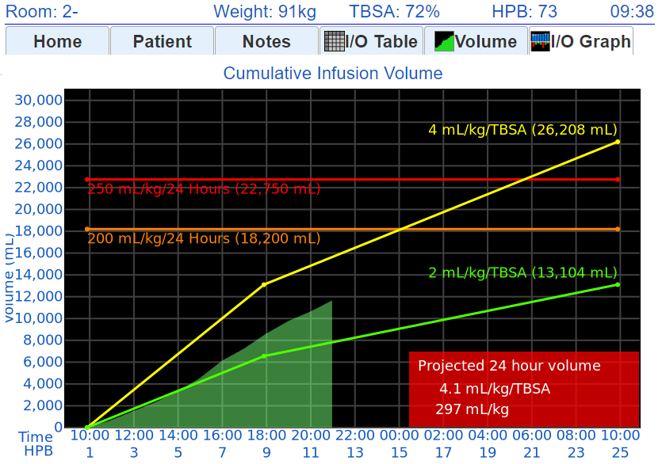
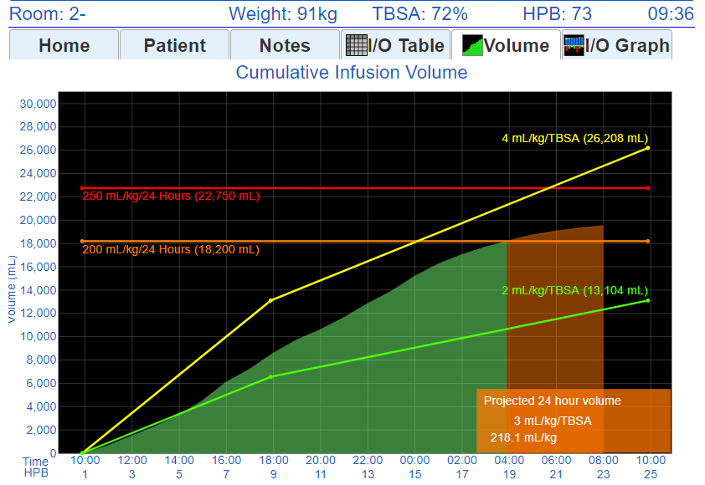
Resuscitation
Example
Timely interventions can result in good resuscitations, even for large (70%+ TBSA) burns

Slide 16
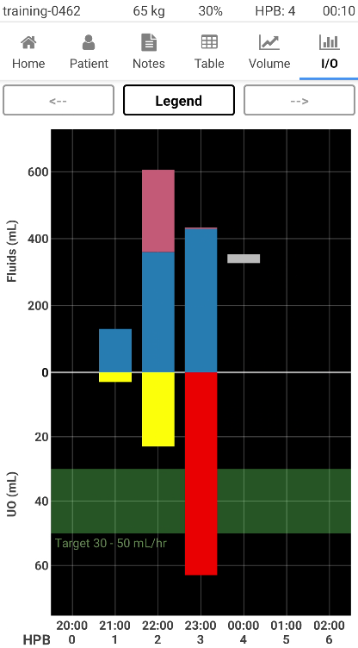
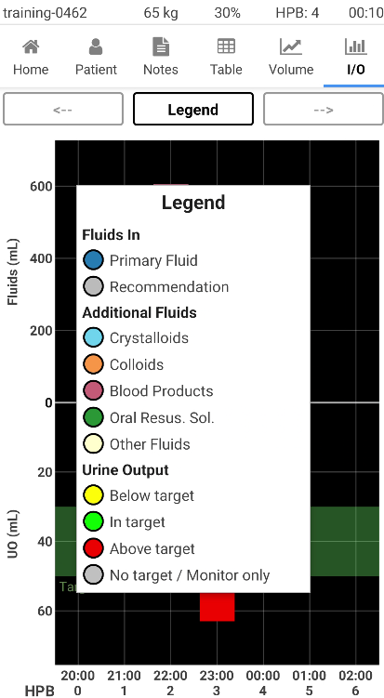
I/O Graph
Additional Fluids
E.g. albumin, FFP, …
(colored by category)
Primary Resus Fluid
Fluids titrated hourly
(dark blue bars)
Urine Output
Green: In Target
Yellow: Below Target
Red: Above Target

Slide 17
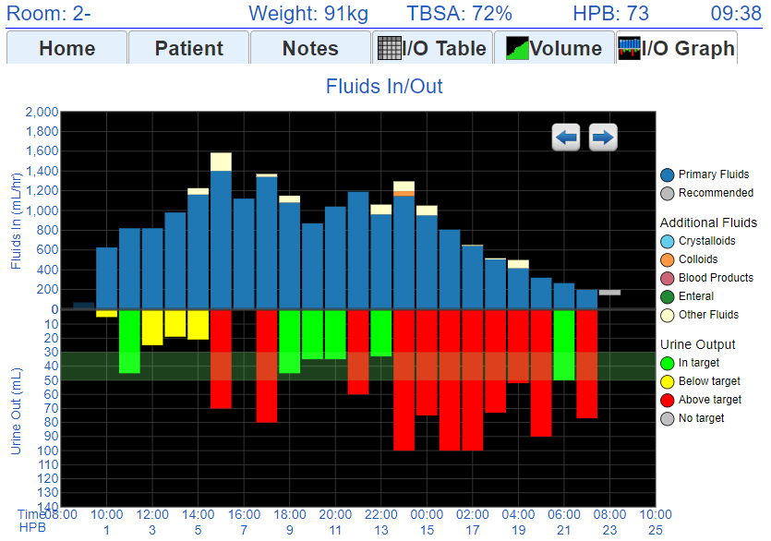
Resuscitation
Example
A good resuscitation (72% TBSA):
Early hours IVF increasing due to capillary leakage, low UOP
IVF plateaus around HPB 8-9
Several hours of high UO prompting quick, smooth de-escalation of IVF, precede end of resuscitation

Slide 18
Part 2: Phone App Walkthrough

Slide 19
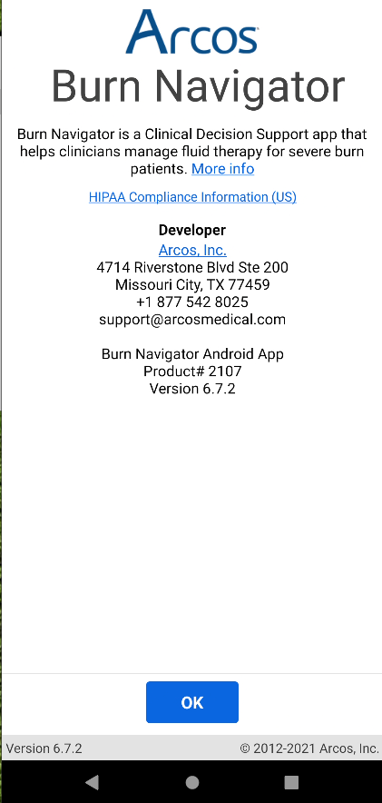
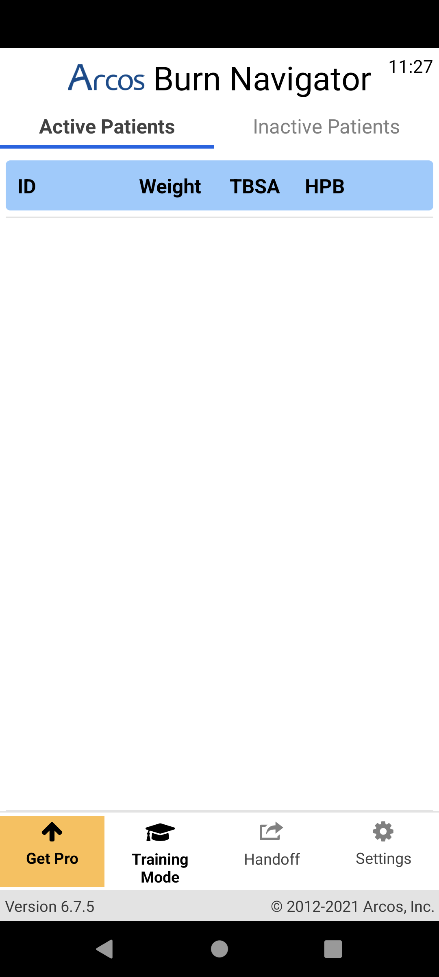
New Patient Setup
Start by pressing “Training Mode” at the bottom of the screen (allows fast-forwarding time)

Slide 20
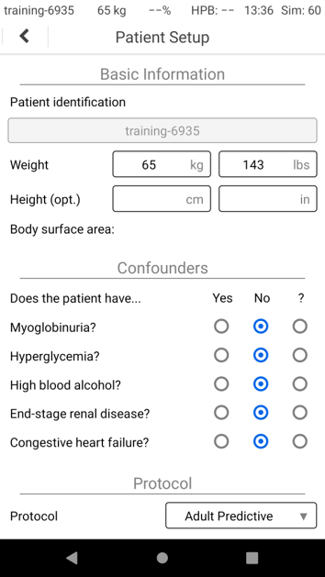
Enter weight from patient scenario.
No confounders

Slide 21
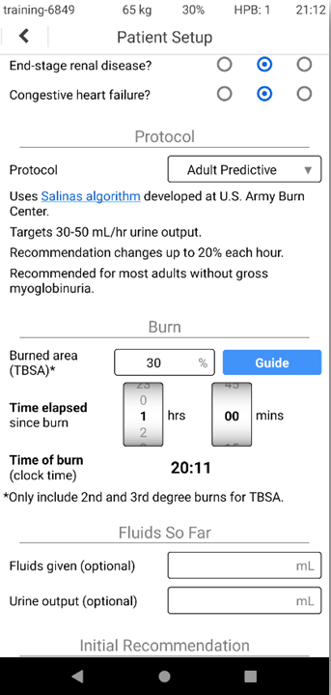
Protocols:
Adult Predictive
  Targets 30-50 mL/hr UO
  Uses UO trend and a predictive algorithm for recommendations
  The size of recommended IV fluid rate changes may vary
Custom
  You can choose the UO target range in mL or mL/kg
  IV fluid rate recommendations will be +/- 10% or no change (unless a safety rule applies)
Monitor Only
  Will not provide IV fluid rate recommendations
  Will provide graphs and safety alerts

Slide 22
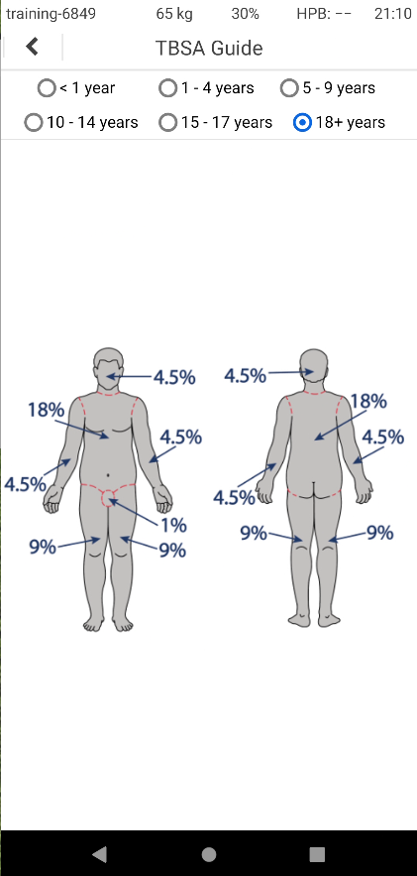

Slide 23
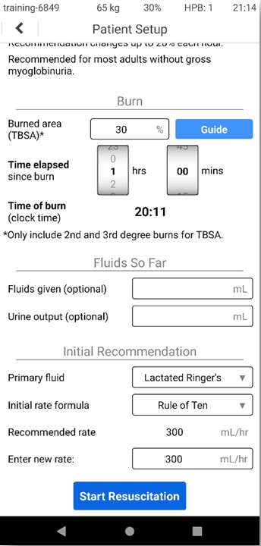
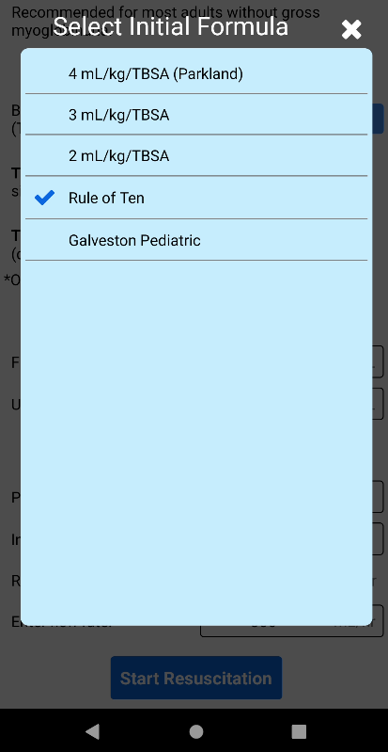
You can add fluids in/out so far here. These are not used for recommendations but will be graphed.
You can choose different formulas (e.g., higher for electrical or inhalation injuries)

Slide 24
You can always choose a different rate than the one recommended
Press “Start Resuscitation” when ready!

Slide 25
Fluid Updates
Clinical Goal: Adequate perfusion with least amount of fluids
Plan: Review urine output each hour, consider any alerts and patient status, and adjust fluid rate as needed
In Training Mode, we can fast-forward time to do top-of-the-hour fluid updates

Slide 26
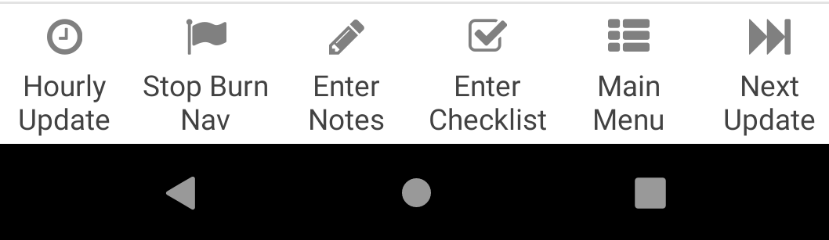
The “Next Update” fast-forward time feature shows in Training Mode but not in normal clinical mode

Slide 27
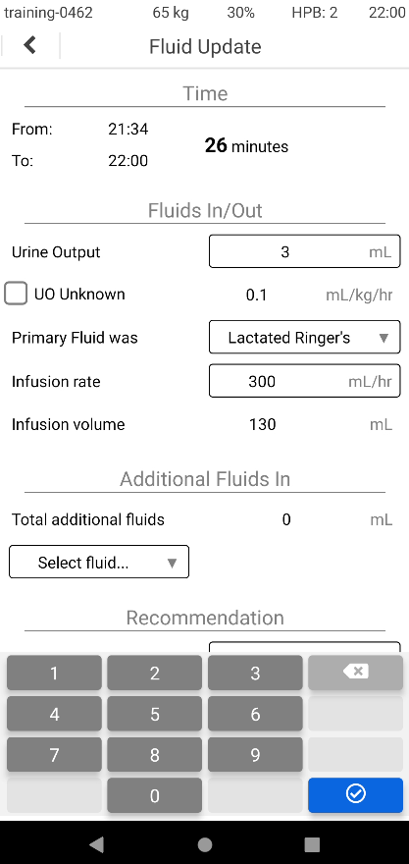
Time period for UO update
Don’t enter additional fluids for this update
X
No additional fluids

Slide 28
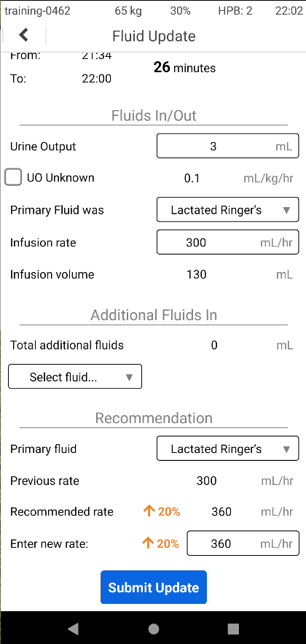
No additional fluids
Accept the recommended rate

Slide 30
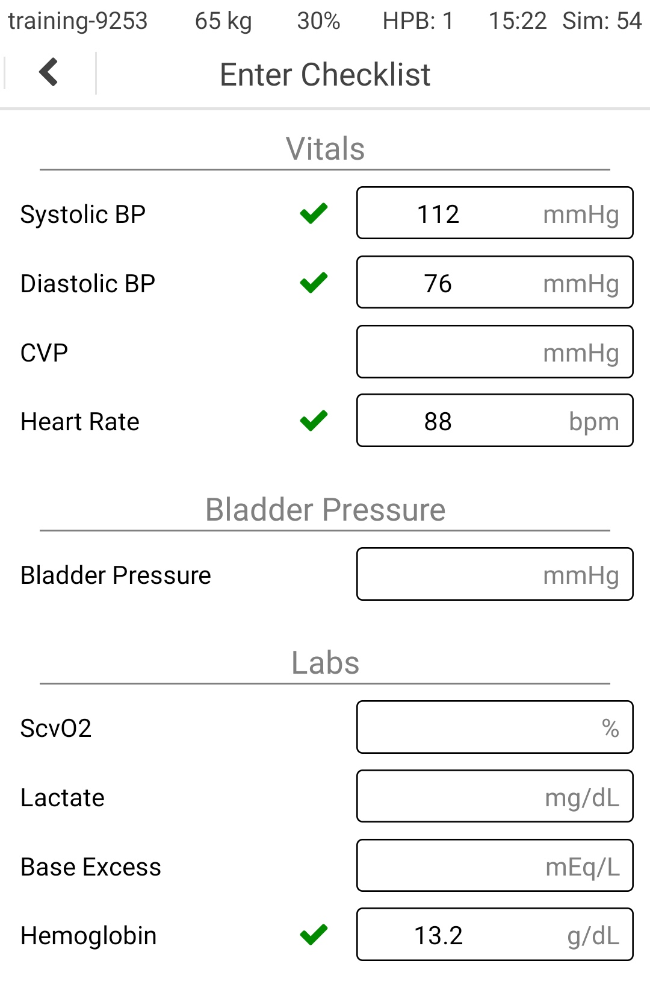
The Checklist is optional
It does not affect the recommendations
But these values are also important for monitoring resuscitation

Slide 31
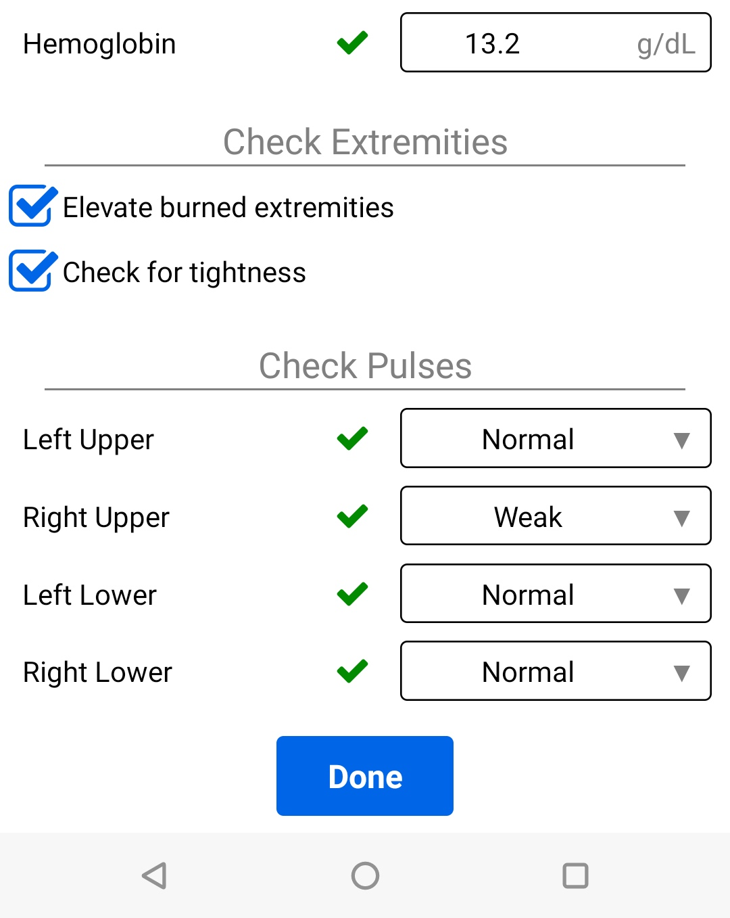

Slide 32
Advance time again

Slide 33
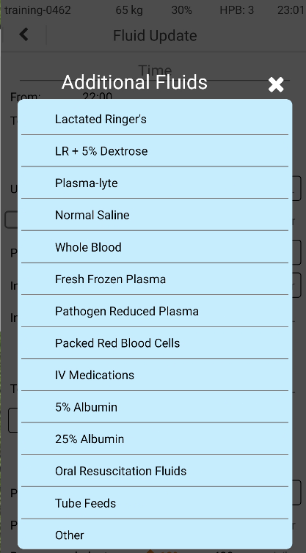
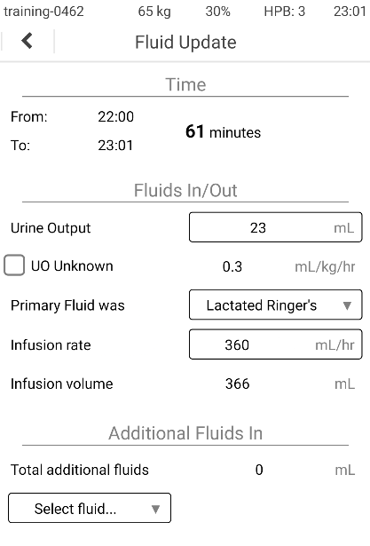
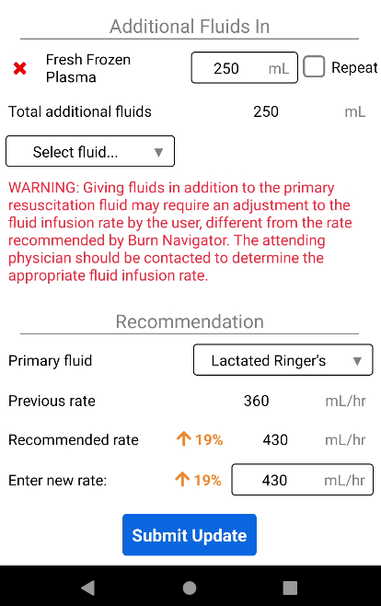
We gave 250 mL FFP

Slide 35
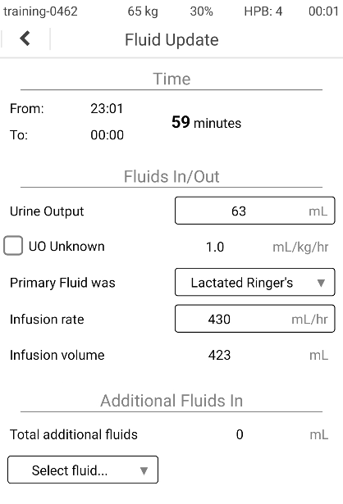
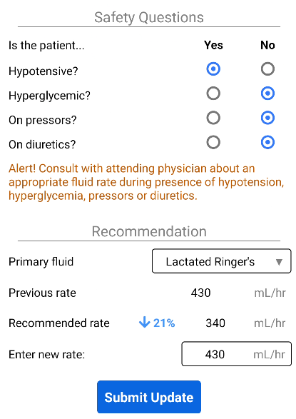
Safety questions appear when a decrease will be recommended
Enter new rate of 430 mL/hr due to hypotension

Slide 36
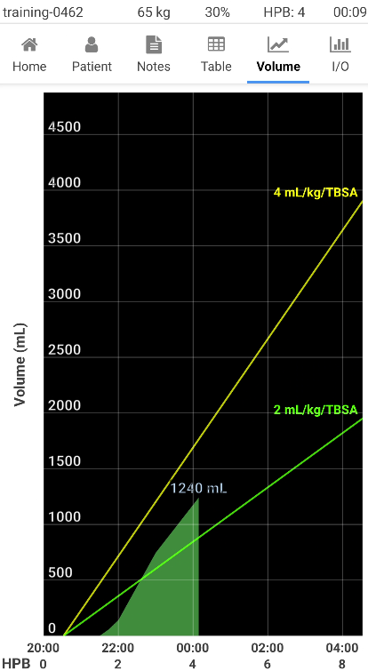
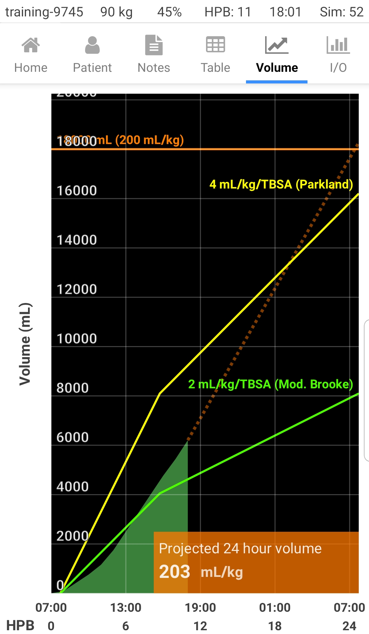
24-hr Volume Projection:
Shows by HPB 10
Assumes you stay at current rate until HPB 24
200-249 mL/kg orange box
250+ mL/kg RED BOX

Slide 38
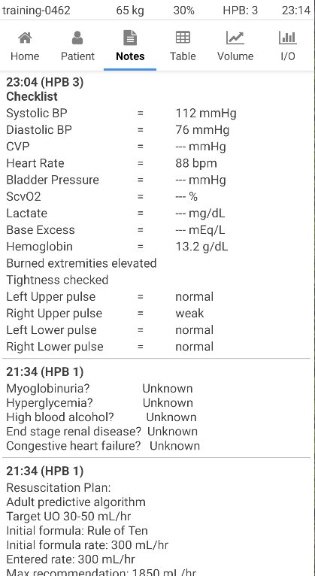
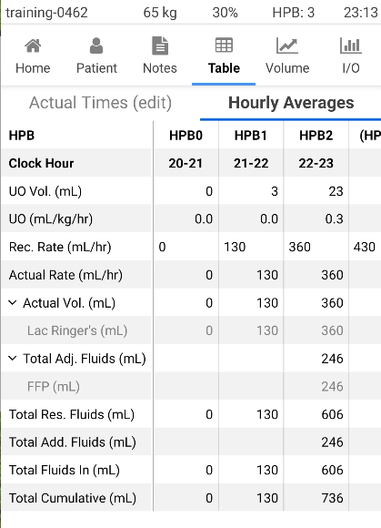

Slide 39
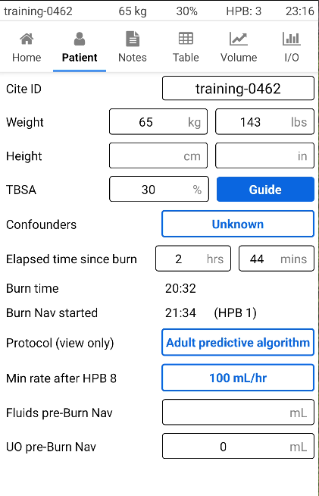
Patient tab lets you:
Change any value from your initial patient setup
Revise TBSA, weight
Edit/update Confounders

Slide 40
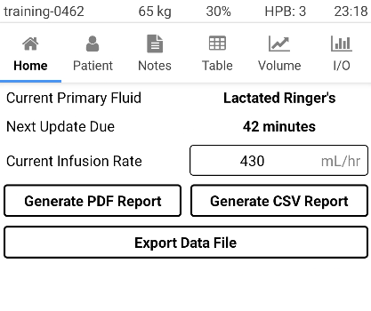
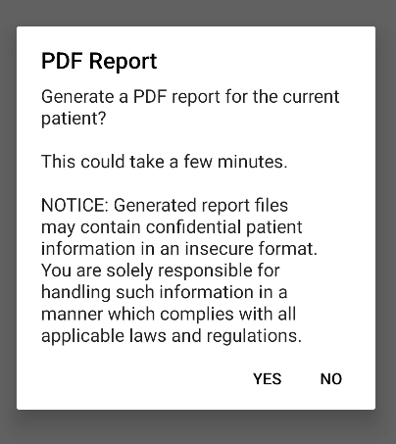
Home tab has data export options
(Data handoff is different and covered next)
Choose to generate a PDF report

Slide 41
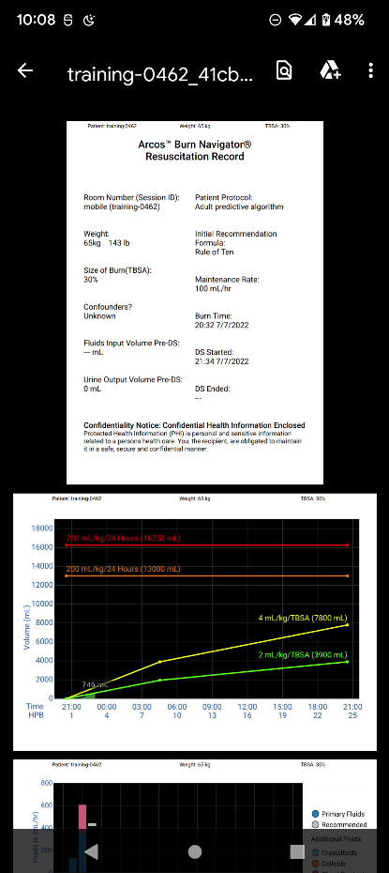
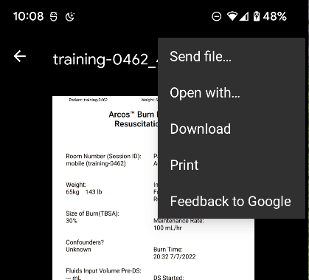
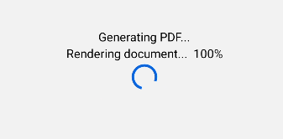
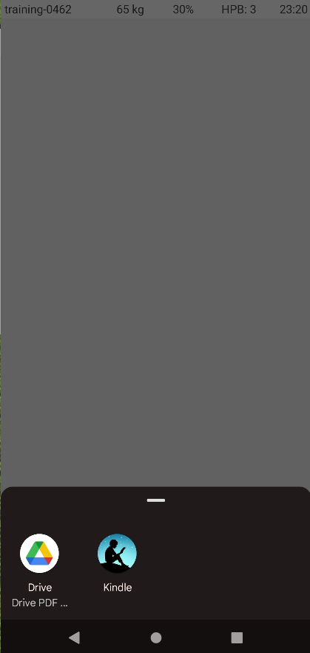
Your PDF viewer app should have options for Print, Send, etc.
You need to choose a PDF viewer app already on your phone

Slide 42
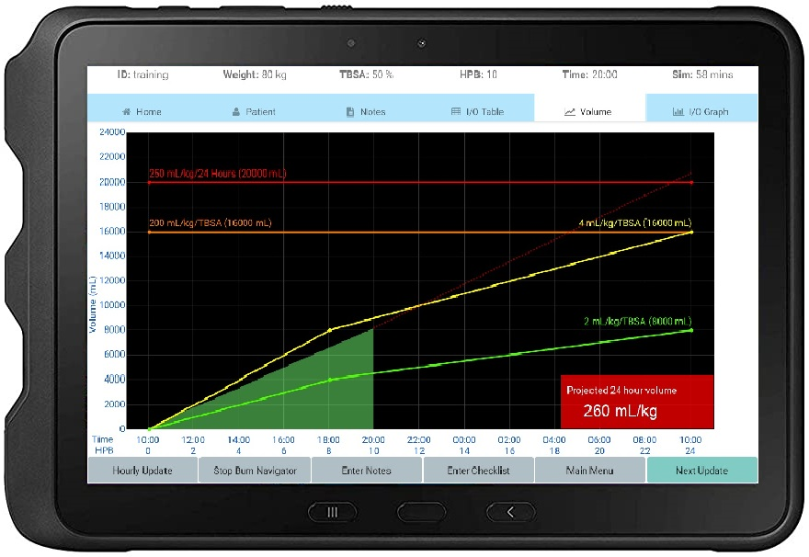

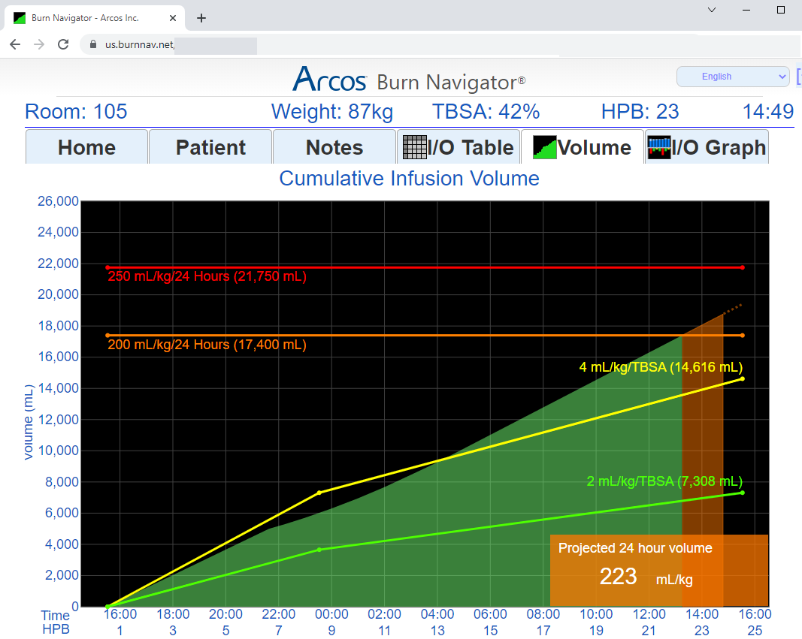
Data Handoff & Integration
Data Handoff
  Role 2 → Transport → Role 3 …
EMR Integration
  Phone or Tablet → Burn Nav Web
  Burn Nav Web → EMR (HL7 messages)
Burn Nav Web Server
EMR

Slide 43



Example safety alerts
Do not follow the recommendations without thought
Recommendations are based primarily on urine output
Urine output is not always a good guide for adequate perfusion
Take the entire clinical situation into consideration

Slide 44
Keep in Mind!
Recommendations are only recommendations!
Understand the whole clinical picture, communicate with the attending physician, and do what’s best for the patient
As a clinical decision support tool, Burn Navigator is not intended to replace clinical decision judgement, rather it informs clinical decision making
Users should always rely on their clinical judgment when making decisions regarding patient care. The Burn Navigator recommendations are not a substitute for clinical judgment.
44

Slide 45

There are several settings you can review and change

Slide 46


Clinical Settings
“Pediatric” defaults are used if weight is <40 kg

Slide 47

License for Clinical Use
Android App Instructions
Contact us for iPhone licenses: info@arcosmedical.com
Buy an individual license:
Unlimited clinical use
One-time purchase for this particular phone
License is consumed (does not transfer to another phone)
Press the “Get Pro” button

Slide 48
Three Versions of Burn Navigator
Web app
  Group account for a hospital
Android/iPhone app
Rugged tablet
10” screen

Slide 49
Please contact us for any questions!
Burn Navigator®
info@arcosmedical.com
877-542-8025
©2023 Arcos, Inc.

